Slide 1

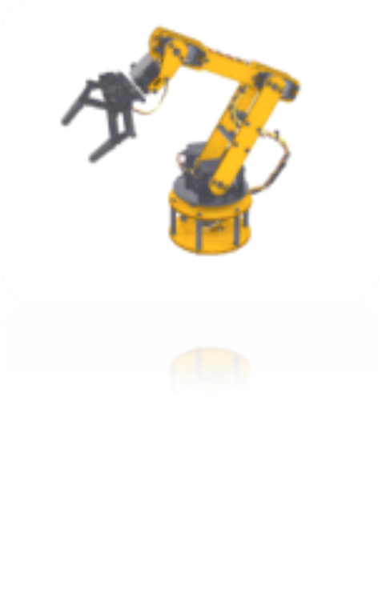
Applied Software Factories
Streamlining Software Development by Exploiting Commonality
Javier Lozano
Iowa .NET User Group
Session # 102

Slide 2


this.ToSlide();
javier@lozanotek.com
http://blog.lozanotek.com
ASP.NET MVP
Leader for Iowa .NET User Group

Slide 3

Info & Goals
Goals
  Share the knowledge
  Get you excited about playing with this stuff
Info
  WOW Factor: LOW
  Ah, Ha! Factor: HIGH
  I will be doing a series of webcasts on the software factories on codetolive.net, so stay tuned!!

Slide 4
Agenda
Why?
  Software Development as an Industry
What?
  A Software Factory is...
  Domain Specific Languages (DSL)
How?
  Software Factories from p&p
  Web Client Software Factory (WCSF)
  Web Service Software Factory (WSSF)
  Microsoft Codename “Acropolis”

Slide 5
Quick Survey…
How many of you use the following?
Code Generation
Build Servers
Unit/Automatic Tests
Graphical Design Tools
Object-Relational Mapping (ORM) Tools
Custom Visual Studio Templates

Slide 6

Agenda: Why?
Software Development Industry
Critical Innovations

Slide 7

Software Development as an Industry
Monolithic construction
  “Code Addiction”
  “Not Invented Here” (NIH) syndrome
  “Roll Your Own Protocol” (RYOP)
One-off development
  No families of products
  Lack of “big picture” thinking/view
Notes:
Talk about how as software producers always want to build vs. buy. In particular, how we at times lack to see the big picture of “commoditizing” our products/services. Use Google as an example, Gmail, Google Calendar and Maps.
Explain how currently tools are too specific to the “core of programming” – syntax checking, highlighting and basic add-ins. Wouldn’t it be nice that these tools could also know about our domain? (ie. Insurance, Banking, Retailer Services, etc.)
We’re always looking for the silver bullet to aid in our business-to-IT translation.

Slide 8
Software Development as an Industry
Tools are too generic
  3GL languages not easily map to “real world”
  Too much freedom
Process immaturity
  Too formal or too agile
Notes:
Talk about how as software producers always want to build vs. buy. In particular, how we at times lack to see the big picture of “commoditizing” our products/services. Use Google as an example, Gmail, Google Calendar and Maps.
Explain how currently tools are too specific to the “core of programming” – syntax checking, highlighting and basic add-ins. Wouldn’t it be nice that these tools could also know about our domain? (ie. Insurance, Banking, Retailer Services, etc.)
We’re always looking for the silver bullet to aid in our business-to-IT translation.

Slide 9
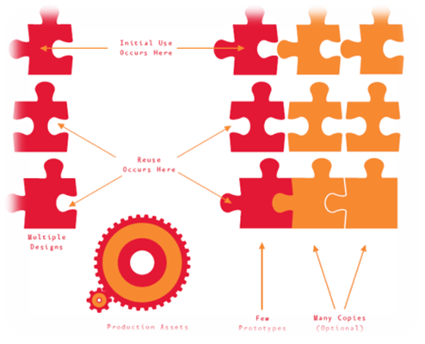
Critical Innovations
Systematic reuse
  Software product families
  Prototype investment
Model-driven development
  Raise the level of abstraction for developers
  Domain specific languages
Process frameworks
  Preserve agility while scaling up
  Active guidance, software agents
Notes:
Explain that as we shift the paradigms of components/objects, that complexity will increase. So we REALLY need to deal with that…how, by adding another layer/tool to aid in the process.

Slide 10
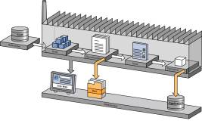
Agenda: What?
A Software Factory is…
  Software Factory Schemas
  Software Factory Templates
Domain Specific Languages (DSL)
  What is a language?
  What is a domain?

Slide 11
A Software Factory is …
“like a restaurant…”
A development environment for a product family
Based on “Economies of Scope” theory
  Reuse similar parts, designs
  Don’t build from scratch
  80-20
Notes:
ARCast.NET – Why The Software Industry Does Not Run Restaurants
http://tinyurl.com/3dd6zs
When people hear the word, “factory”, they think dumb repetitive tasks (something robots would do). Instead they should see the fine orchestration between process and guidance for building a product (car, washing machine, software, etc.)
Economies of scope occur where it is cheaper to produce a wider range of products rather than specialize in just a handful of products.
In automobile manufacturing, for example, multiple similar but distinct automobile designs are often developed by composing existing designs for subcomponents, such as the chassis, body, interior, and drive train, and variants or models are often created by varying features, such as engine and trim level, in existing designs. In other words, the same practices, processes, tools, and materials are used to design and prototype multiple similar but distinct products.

Slide 12
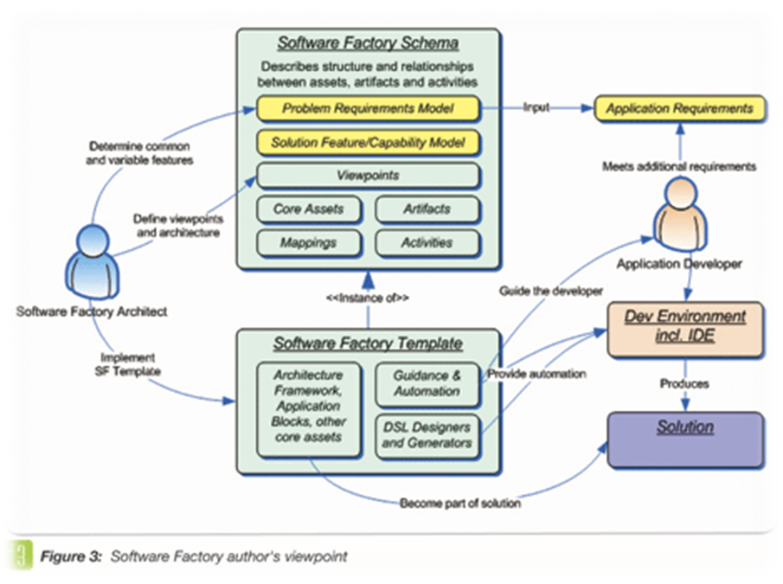
A Software Factory is …
Made up of two main parts:
  Software Factory Schema
  Software Factory Template
Notes:
ARCast.NET – Why The Software Industry Does Not Run Restaurants
http://tinyurl.com/3dd6zs
When people hear the word, “factory”, they think dumb repetitive tasks (something robots would do). Instead they should see the fine orchestration between process and guidance for building a product (car, washing machine, software, etc.)
Economies of scope occur where it is cheaper to produce a wider range of products rather than specialize in just a handful of products.

Slide 13
Software Factory Schemas
“It’s like a recipe...”
  List of ingredients
  Produce family members
Defines a set of viewpoints
  Concerns
  Requirements
  Domain specific
    Conceptual to physical
Notes:
The columns define concerns, while the rows define levels of abstraction. Each cell defines a perspective or viewpoint from which we can build some aspect of the software.
Once the grid has been defined, we can populate it with views that comprise the development artifacts for a specific software product.

Slide 14

Software Factory Templates
“It’s like the ingredients for your recipe…”
Collection of assets
Implementation of schema
Installable content
  Frameworks
  Patterns
  Components, source code
  Samples, Documentations
  Tools

Slide 15
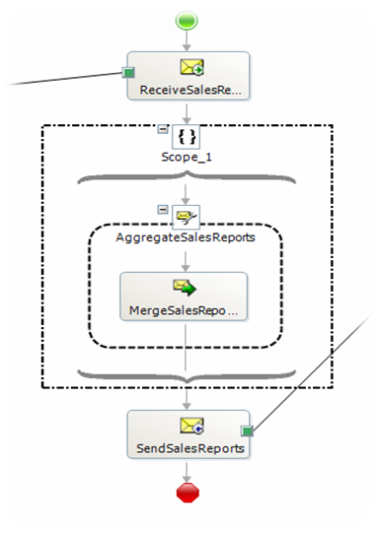
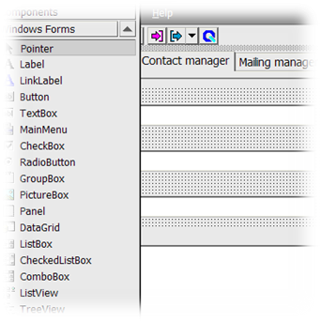
DSL: What is a language?
A model that can be processed by a tool
  Not only documentation
  Code generation & Configuration
Linguistic wrapper
  Visualizing the intent
  Textual/Graphical
  Forms Designer?
  SQL, Orchestration
XML based

Slide 16
DSL: What are “domains”?
Presentation domain
  Form editor
Logic Domain
  BizTalk Orchestration Editor
  Windows Workflow Editor
Data domain
    DTS Editor, NHibernate

Slide 17
Questions?
Come, on…don’t be afraid. ;-)

Slide 18

Agenda: How?
Software Factories from p&p
Web Client Software Factory (WCSF)
Web Service Software Factory (WSSF)
Microsoft Codename “Acropolis”

Slide 19






Software Factories from p&p
Help you build a specific kind of application (smart client, service, etc)
Incorporate a variety of guidance content types and form factors
Guidance, not production products.
App Block Library
Guides
App Blocks
Patterns
Help
Code Samples

Slide 20
Required Software
Guidance Automation Extensions (GAX)
Guidance Automation Toolkit (GAT)
EnterpriseLibrary (latest)
Visual Studio 2005 SP1
VS2005 Extensions for Windows Workflow Foundation
VS2005 Extensions for .NET Framework 3.0 (WCF & WPF), November 2006 CTP

Slide 21
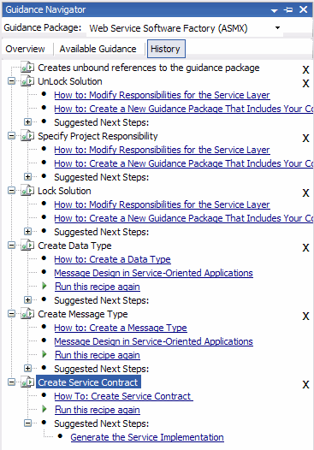
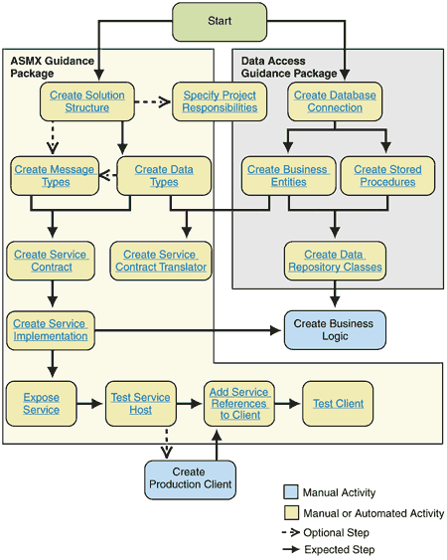
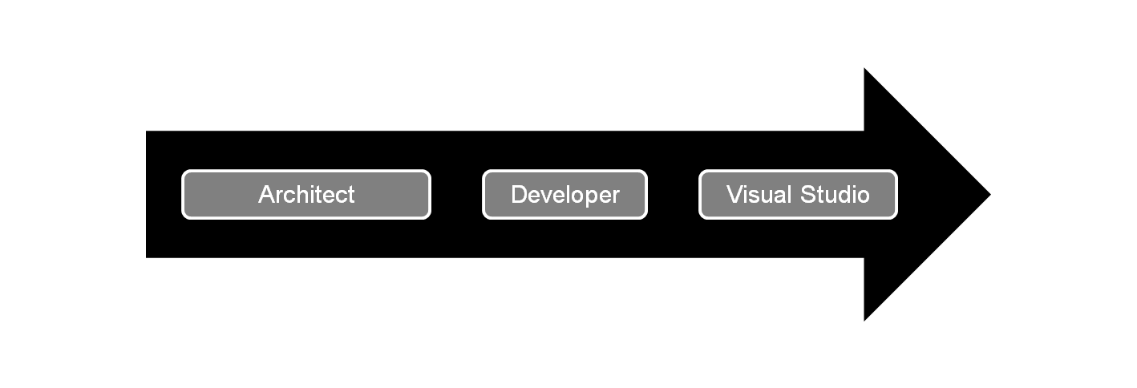
Software Factories from p&p

Slide 22
Component Overview
WCSF: Demo
Notes:
©2005 Microsoft Corporation. All rights reserved.
This presentation is for informational purposes only. Microsoft makes no warranties, express or implied, in this summary.

Slide 23

WCSF: What does it address?
  Modularity
  Separating concerns: Shell, business logic, infrastructure
  Development by separate teams
  Deploy without affecting other teams work
  Look and feel consistent across teams
  Avoid duplication of common services such as security and logging
  UX
  Navigation
  Role Based UI
  Security
  Securing Data
  Authentication / Authorization
  Data Input Validation

Slide 24
WCSF: What does it provide?
Guidance and tools for Web Client development
Declarative navigation and page flow
Consistent and Profile based UI
Simplified Deployment Model for loosely coupled modules
Visual Studio 2005 Integration
Customizable and extensible

Slide 25
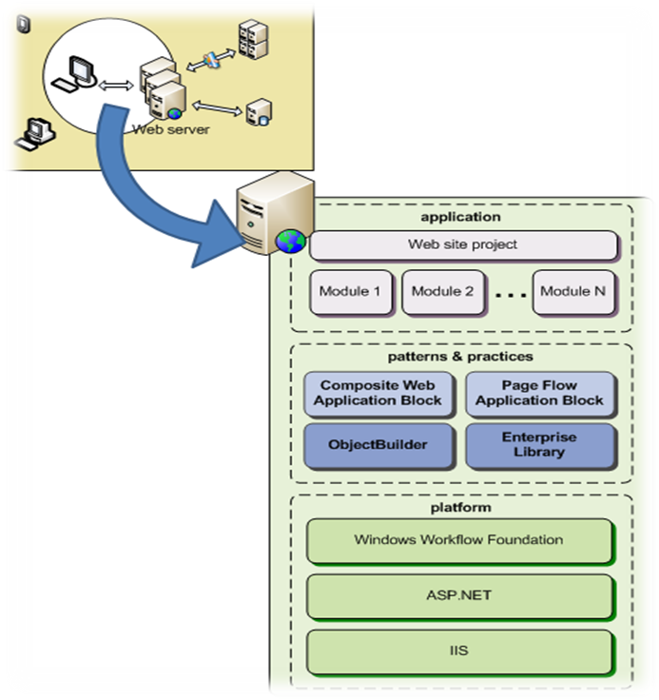
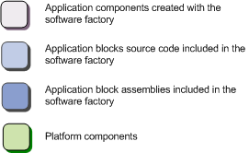
WCSF: Components
Composite Web Application Block
Page Flow Application Block
ObjectBuilder
Enterprise Library

Slide 26
WCSF: Composite Web Application Block
Provides the plumbing for a composite web application
    Utilizes ObjectBuilder dependency injection framework
    Shares some concepts with Composite UI App Block
    Introduces modules as separate units of deployment
Notes:
MICROSOFT CONFIDENTIAL
© 2006 Microsoft Corporation. All rights reserved. Microsoft, Windows, Windows Vista and other product names are or may be registered trademarks and/or trademarks in the U.S. and/or other countries.
The information herein is for informational purposes only and represents the current view of Microsoft Corporation as of the date of this presentation. Because Microsoft must respond to changing market conditions, it should not be interpreted to be a commitment on the part of Microsoft, and Microsoft cannot guarantee the accuracy of any information provided after the date of this presentation.
MICROSOFT MAKES NO WARRANTIES, EXPRESS, IMPLIED OR STATUTORY, AS TO THE INFORMATION IN THIS PRESENTATION.

Slide 27


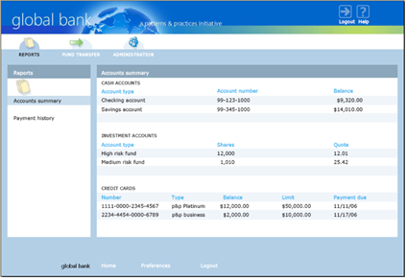



WCSF: Architecture
Shell using Master Page, AccessDenied.htm
Visual Icons
Root Composition Container
View
Site Map Node
View
Site Map Node
Comp Container
Shared Services
Authorization Service
Service
Service
Module
Module
Catalog

Slide 28
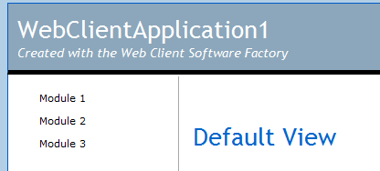
Site map navigation
Modules load dynamically
They need to publish what they can do
SiteMapBuilder is the key
Uses ASP.NET’s SiteMap support
Can be role based
Shell
  SiteMapNodeInfo moduleNode =
  new SiteMapNodeInfo("Module1", "~/Module1/Default.aspx", "Module1");
  siteMapBuilderService.AddNode(moduleNode);
  // Specify the parent node
  siteMapBuilderService.AddNode(moduleNode, parentNode);
  // Specify the preferred display order
  siteMapBuilderService.AddNode(moduleNode, 100);
  // Specify the authorization rule
  siteMapBuilderService.AddNode(moduleNode, “AllowViewModule1”);
Site Map Navigation Service
Site Map Node
Module1
Site Map Node
Module2
Site Map Node
Module3
Notes:
MICROSOFT CONFIDENTIAL
© 2006 Microsoft Corporation. All rights reserved. Microsoft, Windows, Windows Vista and other product names are or may be registered trademarks and/or trademarks in the U.S. and/or other countries.
The information herein is for informational purposes only and represents the current view of Microsoft Corporation as of the date of this presentation. Because Microsoft must respond to changing market conditions, it should not be interpreted to be a commitment on the part of Microsoft, and Microsoft cannot guarantee the accuracy of any information provided after the date of this presentation.
MICROSOFT MAKES NO WARRANTIES, EXPRESS, IMPLIED OR STATUTORY, AS TO THE INFORMATION IN THIS PRESENTATION.

Slide 29
WCSF: Page Flow Application Block
Tackles the “Navigation” Technical Challenge
Allows Page design and Page navigation to be separated
Allows visualization of the navigation path
Notes:
©2005 Microsoft Corporation. All rights reserved.
This presentation is for informational purposes only. Microsoft makes no warranties, express or implied, in this summary.

Slide 30

WCSF: Page Flow Application Block
Supports serializable state, flows can be suspended
Supports Abortable and non-abortable flows
Extensible:
  In-the-box solution utilizes Windows Workflow Foundation
  Additional navigation implementations can be created
Notes:
©2005 Microsoft Corporation. All rights reserved.
This presentation is for informational purposes only. Microsoft makes no warranties, express or implied, in this summary.

Slide 31
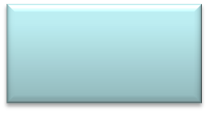
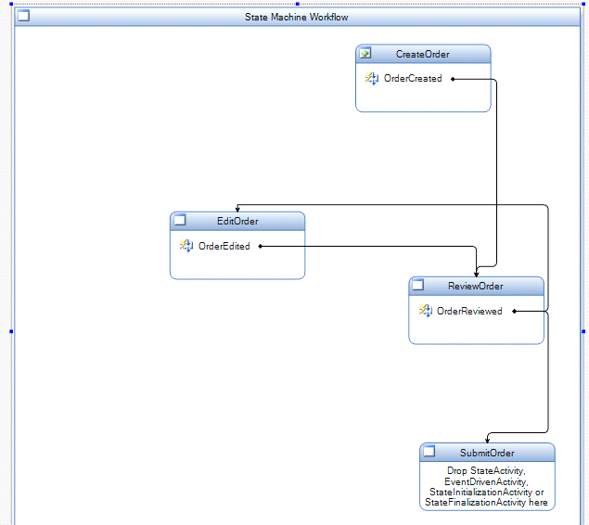
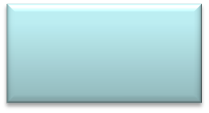

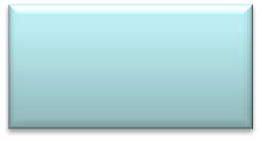

WCSF: Page Flow Application Block
CreateOrder.aspx
ReviewOrder.aspx
User
Browser
EditOrder.aspx
Submit Order.aspx
Notes:
©2005 Microsoft Corporation. All rights reserved.
This presentation is for informational purposes only. Microsoft makes no warranties, express or implied, in this summary.

Slide 32
WCSF: Model View Presenter Pattern
A UI pattern for that separates the UI-Centric business logic from the UI itself.
Allows unit testing of UI logic
Makes the UI less brittle
Can be used in several ways:
  With a Model
  With an Application Controller
Model
View
Presenter
Notes:
MICROSOFT CONFIDENTIAL
© 2006 Microsoft Corporation. All rights reserved. Microsoft, Windows, Windows Vista and other product names are or may be registered trademarks and/or trademarks in the U.S. and/or other countries.
The information herein is for informational purposes only and represents the current view of Microsoft Corporation as of the date of this presentation. Because Microsoft must respond to changing market conditions, it should not be interpreted to be a commitment on the part of Microsoft, and Microsoft cannot guarantee the accuracy of any information provided after the date of this presentation.
MICROSOFT MAKES NO WARRANTIES, EXPRESS, IMPLIED OR STATUTORY, AS TO THE INFORMATION IN THIS PRESENTATION.

Slide 33
WCSF: Services
A service is name for an object that provides functionality to other components (the components can be in the same module or in another module) in a loosely coupled way.
Characteristics
I don’t know or care who created it
I don’t know or care what the implementation is
I am not responsible for disposing it.
ILogging
Service
Customer
IAccounts
Service
Notes:
MICROSOFT CONFIDENTIAL
© 2006 Microsoft Corporation. All rights reserved. Microsoft, Windows, Windows Vista and other product names are or may be registered trademarks and/or trademarks in the U.S. and/or other countries.
The information herein is for informational purposes only and represents the current view of Microsoft Corporation as of the date of this presentation. Because Microsoft must respond to changing market conditions, it should not be interpreted to be a commitment on the part of Microsoft, and Microsoft cannot guarantee the accuracy of any information provided after the date of this presentation.
MICROSOFT MAKES NO WARRANTIES, EXPRESS, IMPLIED OR STATUTORY, AS TO THE INFORMATION IN THIS PRESENTATION.

Slide 34
WCSF: Dependency Injection
Pattern that allows abstractly defining object dependencies and passing in concrete implementations at runtime.
Benefits:
Allows you to decouple your classes from logic for retrieving dependencies.
Dependencies can be replaced or updated requiring minimal or no changes to your classes’ source code.
Allows writing classes that depend on services whose concrete implementation is not known at compile time.
Facilitates testing your classes in isolation using test doubles.
Work Item
ILogging
Service
Locates
Customer
Object
Builder
Injects
Notes:
MICROSOFT CONFIDENTIAL
© 2006 Microsoft Corporation. All rights reserved. Microsoft, Windows, Windows Vista and other product names are or may be registered trademarks and/or trademarks in the U.S. and/or other countries.
The information herein is for informational purposes only and represents the current view of Microsoft Corporation as of the date of this presentation. Because Microsoft must respond to changing market conditions, it should not be interpreted to be a commitment on the part of Microsoft, and Microsoft cannot guarantee the accuracy of any information provided after the date of this presentation.
MICROSOFT MAKES NO WARRANTIES, EXPRESS, IMPLIED OR STATUTORY, AS TO THE INFORMATION IN THIS PRESENTATION.

Slide 35
Service and Data contracts in WCF
WSSF: Demo
Notes:
©2005 Microsoft Corporation. All rights reserved.
This presentation is for informational purposes only. Microsoft makes no warranties, express or implied, in this summary.

Slide 36
WSSF: What does it address?
Message and service interface design
WSDL-first service design (also XSD)
Exception shielding and exception handling
Applying message-level security
Semantic and security code analysis
Notes:
MICROSOFT CONFIDENTIAL
© 2006 Microsoft Corporation. All rights reserved. Microsoft, Windows, Windows Vista and other product names are or may be registered trademarks and/or trademarks in the U.S. and/or other countries.
The information herein is for informational purposes only and represents the current view of Microsoft Corporation as of the date of this presentation. Because Microsoft must respond to changing market conditions, it should not be interpreted to be a commitment on the part of Microsoft, and Microsoft cannot guarantee the accuracy of any information provided after the date of this presentation.
MICROSOFT MAKES NO WARRANTIES, EXPRESS, IMPLIED OR STATUTORY, AS TO THE INFORMATION IN THIS PRESENTATION.

Slide 37
WSSF: What does it address?
Planning for the migration to WCF
Message validation (service behavior)
Message translation to business entities
Designing business entities in the domain model
Designing, building, and invoking the data access layer
Notes:
MICROSOFT CONFIDENTIAL
© 2006 Microsoft Corporation. All rights reserved. Microsoft, Windows, Windows Vista and other product names are or may be registered trademarks and/or trademarks in the U.S. and/or other countries.
The information herein is for informational purposes only and represents the current view of Microsoft Corporation as of the date of this presentation. Because Microsoft must respond to changing market conditions, it should not be interpreted to be a commitment on the part of Microsoft, and Microsoft cannot guarantee the accuracy of any information provided after the date of this presentation.
MICROSOFT MAKES NO WARRANTIES, EXPRESS, IMPLIED OR STATUTORY, AS TO THE INFORMATION IN THIS PRESENTATION.

Slide 38
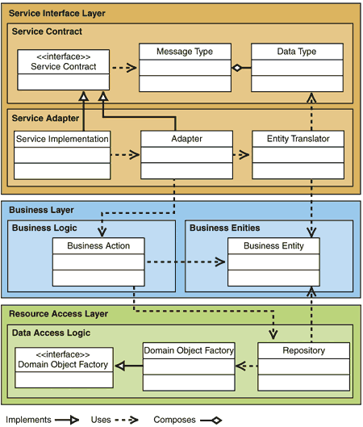
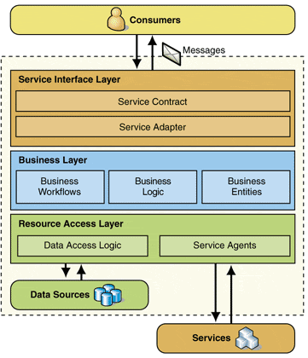
WSSF: What does it provide?
Designing messages and
service interfaces
Applying exception shielding
and handling
Designing business entities in the domain model
Translating messages to and from business entities
Designing, building, and invoking the data access layer
Planning for the migration to WCF

Slide 39
Acropolis: What is it?
Components and tools that make it easier for developers to build and manage modular, business focused, client .NET applications.
Acropolis is part of the “.NET Client Futures” wave of releases, our preview of upcoming technologies for Windows client development.
Notes:
MICROSOFT CONFIDENTIAL
© 2006 Microsoft Corporation. All rights reserved. Microsoft, Windows, Windows Vista and other product names are or may be registered trademarks and/or trademarks in the U.S. and/or other countries.
The information herein is for informational purposes only and represents the current view of Microsoft Corporation as of the date of this presentation. Because Microsoft must respond to changing market conditions, it should not be interpreted to be a commitment on the part of Microsoft, and Microsoft cannot guarantee the accuracy of any information provided after the date of this presentation.
MICROSOFT MAKES NO WARRANTIES, EXPRESS, IMPLIED OR STATUTORY, AS TO THE INFORMATION IN THIS PRESENTATION.

Slide 40
Acropolis: What is it?
With Acropolis you will be able to:
  Quickly create WPF enabled user experiences for your client applications.
  Build client applications from reusable, connectable, modules that allow you to easily create complex, business-focused applications in less time.
  Integrate and host your modules in applications such as Microsoft Office, or quickly build stand-alone client interfaces.
Notes:
MICROSOFT CONFIDENTIAL
© 2006 Microsoft Corporation. All rights reserved. Microsoft, Windows, Windows Vista and other product names are or may be registered trademarks and/or trademarks in the U.S. and/or other countries.
The information herein is for informational purposes only and represents the current view of Microsoft Corporation as of the date of this presentation. Because Microsoft must respond to changing market conditions, it should not be interpreted to be a commitment on the part of Microsoft, and Microsoft cannot guarantee the accuracy of any information provided after the date of this presentation.
MICROSOFT MAKES NO WARRANTIES, EXPRESS, IMPLIED OR STATUTORY, AS TO THE INFORMATION IN THIS PRESENTATION.

Slide 41
Acropolis: What is it?
Change the look and feel of your application quickly using built-in themes, or custom designs using XAML.
Add features such as workflow navigation and user-specific views with minimal coding.
Manage, update, and deploy your application modules quickly and easily.
Notes:
MICROSOFT CONFIDENTIAL
© 2006 Microsoft Corporation. All rights reserved. Microsoft, Windows, Windows Vista and other product names are or may be registered trademarks and/or trademarks in the U.S. and/or other countries.
The information herein is for informational purposes only and represents the current view of Microsoft Corporation as of the date of this presentation. Because Microsoft must respond to changing market conditions, it should not be interpreted to be a commitment on the part of Microsoft, and Microsoft cannot guarantee the accuracy of any information provided after the date of this presentation.
MICROSOFT MAKES NO WARRANTIES, EXPRESS, IMPLIED OR STATUTORY, AS TO THE INFORMATION IN THIS PRESENTATION.

Slide 42
RSSEagle Sample
Acropolis: Demo
Notes:
©2005 Microsoft Corporation. All rights reserved.
This presentation is for informational purposes only. Microsoft makes no warranties, express or implied, in this summary.

Slide 43
Resources
Software Factories: Assembling Applications with Patterns, Models, Frameworks, and Tools
  http://tinyurl.com/2o9qum
DSL Tools for Visual Studio
  http://tinyurl.com/35jecs
Web Client Software Factory on CodePlex
  http://www.codeplex.com/websf
Design Patterns: Model View Presenter
  http://tinyurl.com/kcs9m

Slide 44
Resources
Design Patterns: Dependency Injection
  http://tinyurl.com/fhdf3
Windows Workflow Foundation
  http://wf.netfx3.com
Service Software Factory on CodePlex
  http://www.codeplex.com/servicefactory
Windows Communication Foundation
  http://wcf.netfx3.com
Microsoft Codename “Acropolis”
  http://windowsclient.net/Acropolis/

Slide 45
Resources
Microsoft Codename “Acropolis”
  http://windowsclient.net/Acropolis/

Slide 46
Questions?
Come, on…don’t be afraid. ;-)

Slide 47
Thanks for coming!
Javier Lozano
  javier@lozanotek.com
  http://blog.lozanotek.com
Please complete the feedback for this session.
Session #: 102
Enjoy the remainder of HDC and your stay in Omaha!

